Slide 1


Changes in the trade-wind atmospheric boundary layer due to
mesoscale SST variability
in a coupled simulation
Presenter: Alessandro Storer
Supervision: prof. Claudia Pasquero
prof. Dino Zardi (Univ. Trento)
Meteo X Change conference, 10 – 11 April 2025

Slide 2
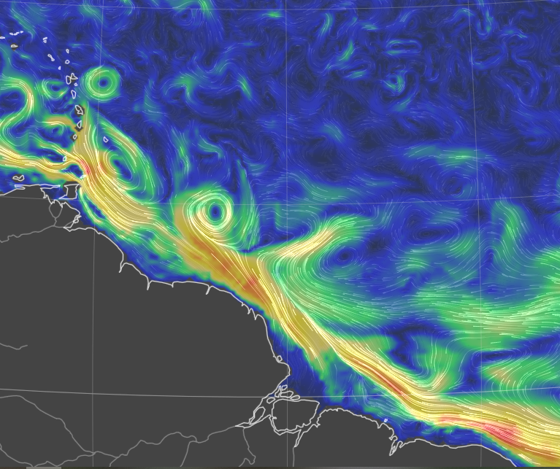
The Sub - / Mesoscale – an introduction
Important in the global energy budget!
(Renault et al. 2023, Seo et al. 2023,
Bishop et al. 2020)
Thermal feedback TFB
Modulates local temperature, stability and circulation through modified thermodynamic fluxes
10N
NUMERICAL DATASETS
- Conceptual bulk model for PBL
High-resolution coupled simulation:
WRF 2km atmosphere
CROCO 1km ocean
Daily averages in February 2020
EUREC4A region Stevens et al. 2021
EQ
60W
50W
40W
Sea sfc currents on 6 th April 2025
earth.null.school
Notes:
Check minobe’s and chelton’s, fabien’s articles for summarizing image

Slide 3
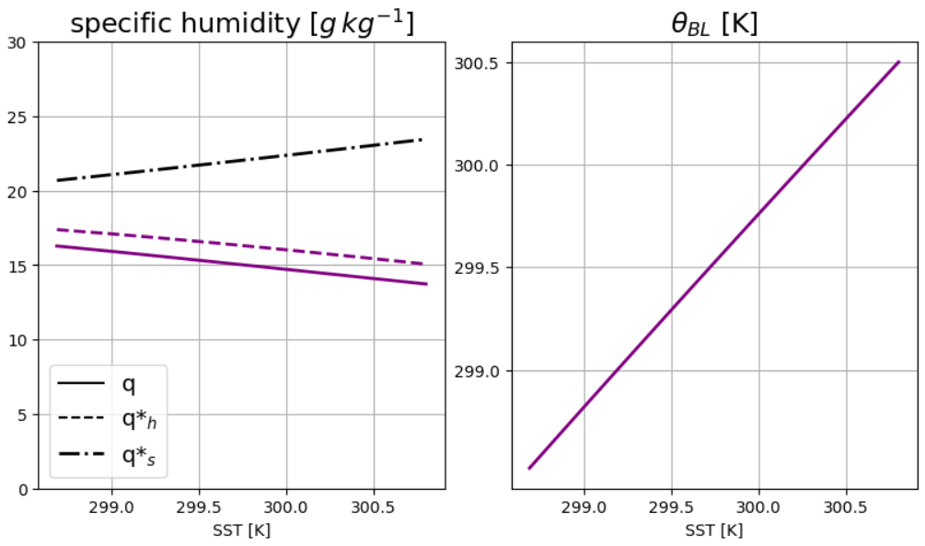
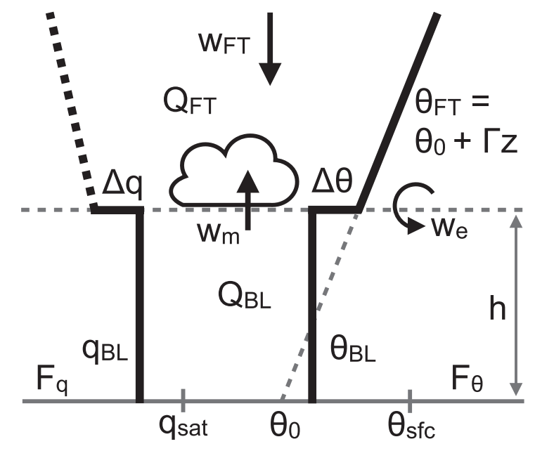
From lower complexity ….
Conceptual Bulk model
starring:
Stevens et al. 2002
Neggers et al. 2006
Naumann et al. 2019
Moisture decreases!
Temperature follows SST
!?

Slide 4
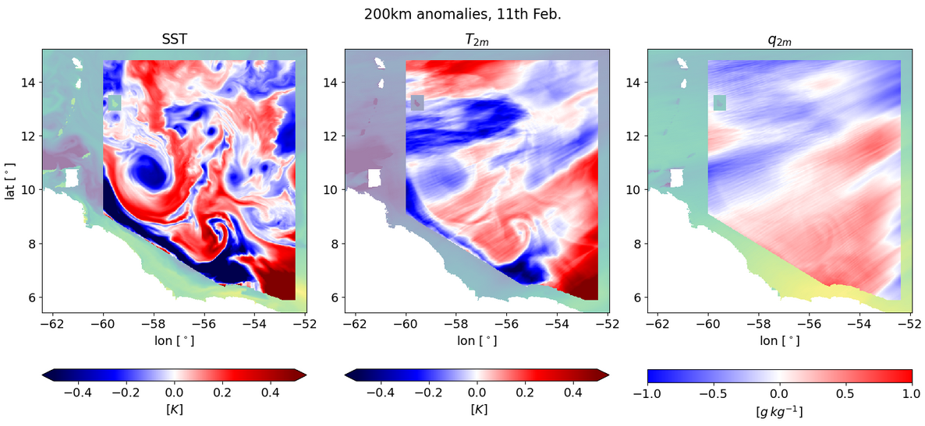
… to higher complexity – Coupled simulation
High-pass filtered fields (200 km) – 11th Feb. 2020

Slide 5

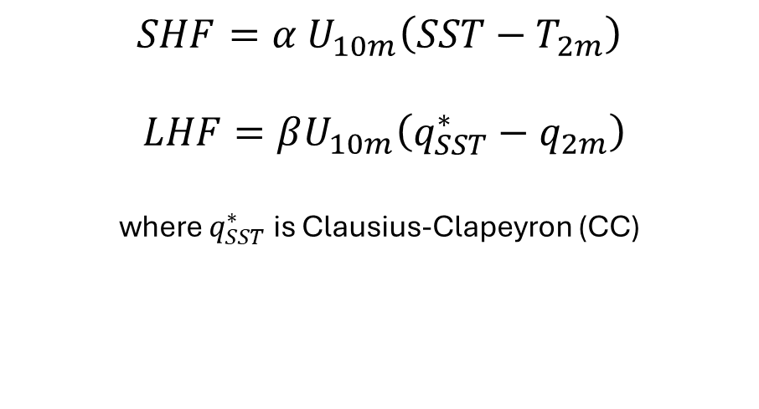
Sensitivity of surface fluxes to SST
MABL
$$SHF=α U_{10m}\left(SST−T_{2m}\right)$$
$$LHF=βU_{10m}\left(q_{SST}^{∗}−q_{2m}\right)$$
where $q_{SST}^{∗}$ is Clausius-Clapeyron (CC)
SHF’ ?
LHF’ ?
SHF’ ?
LHF’ ?
$$sensitivities == \frac{∂HF′}{∂SST′}$$
SST’ < 0
SST’ > 0
Notes:
Check how WRF is computing surface fluxes in the coupled simulation

Slide 6
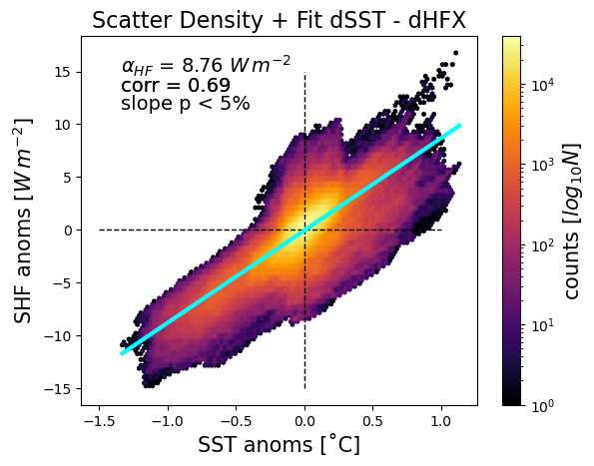
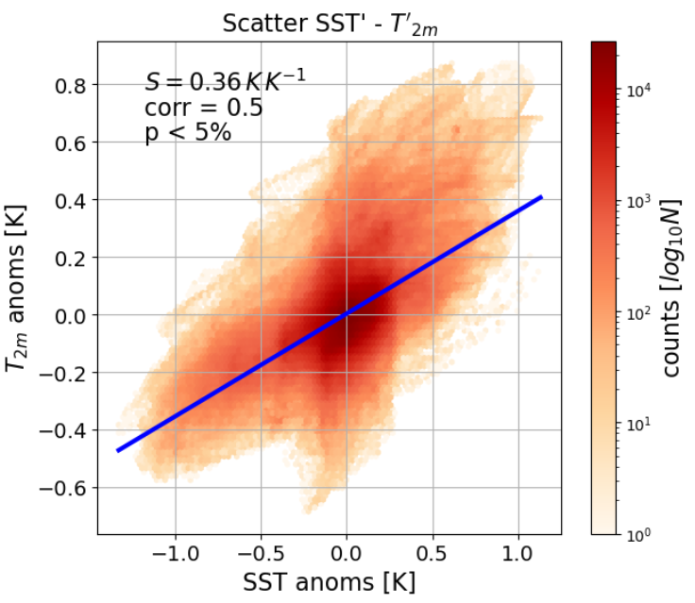

Sensible Heat Flux (SHF) and temperature
SHF anomalies
$T_{2m}$ anomalies

Slide 7
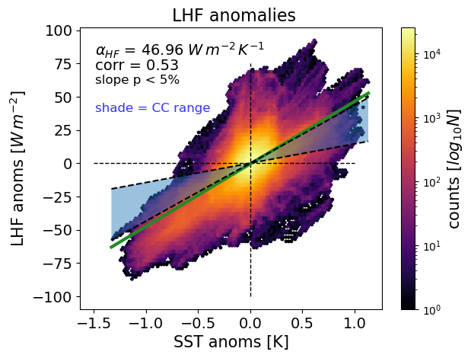
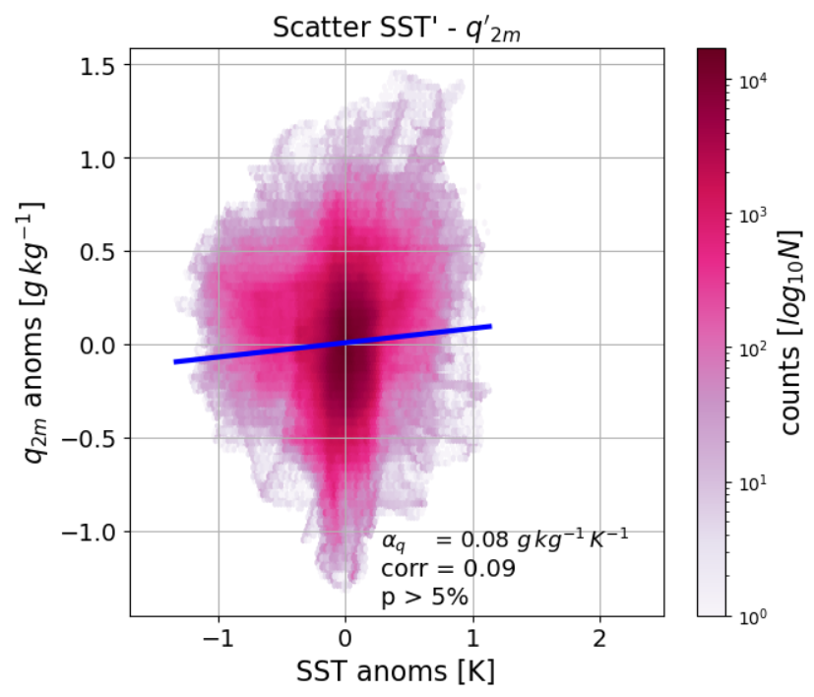
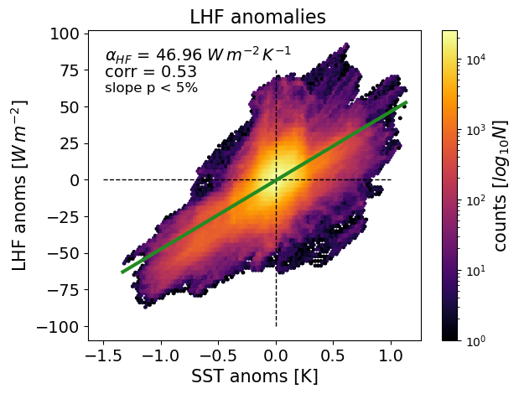
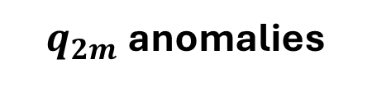
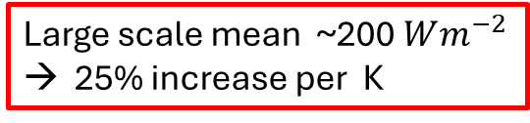
Latent Heat Flux (LHF) and moisture
LHF anomalies
$q_{2m}$anomalies
Large scale mean ~$\text{200} Wm^{−2}$
→ 25% increase per K

Slide 8

$T_{2m}$ vs $q_{2m}$ response
$T_{2m}$ anomalies
$q_{2m}$anomalies

Slide 9
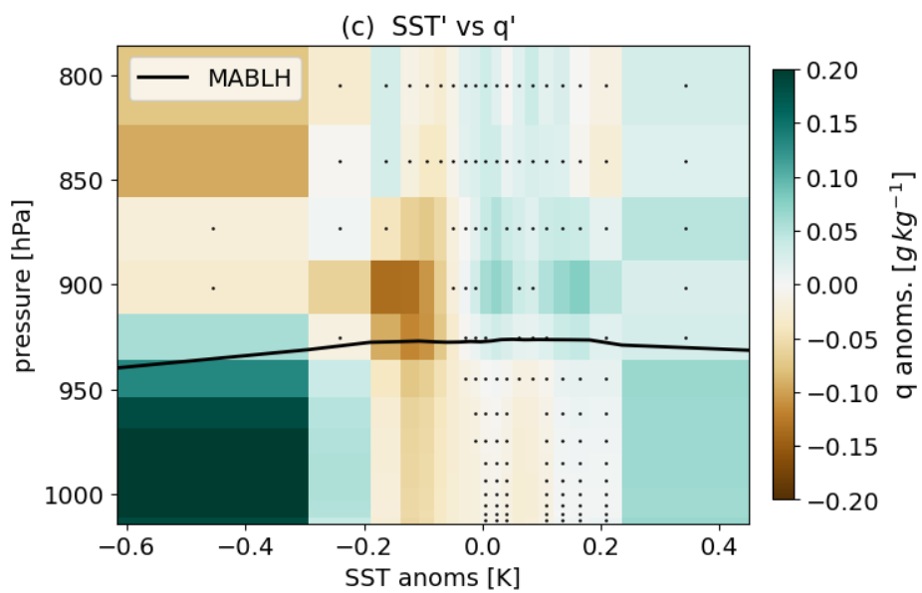
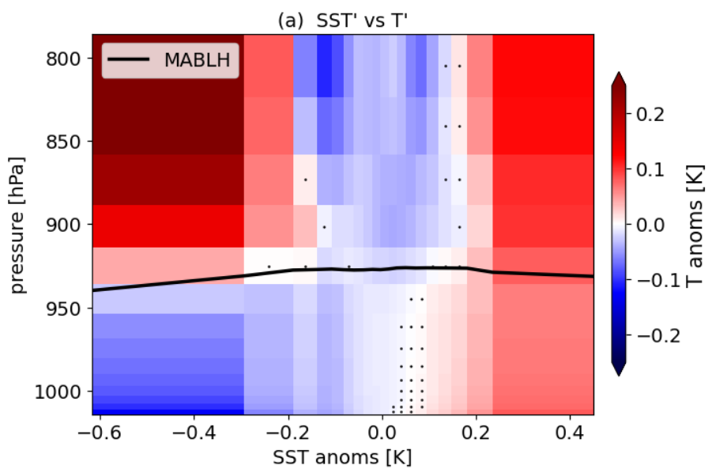
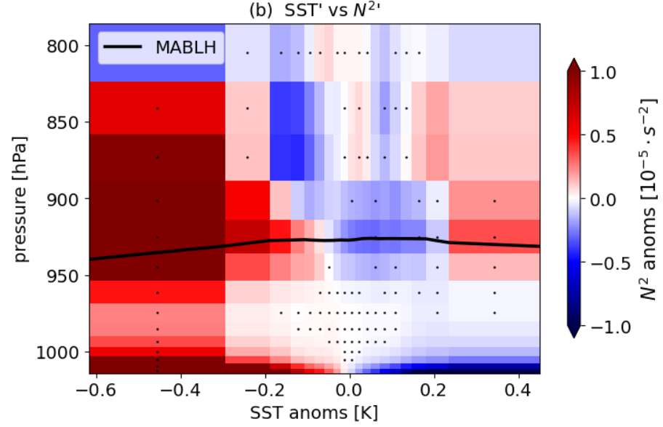
Air column response!
Specific humidity anomalies
Temperature anomalies
Stability anomalies
Compare with
Borgnino et al. 2025

Slide 10
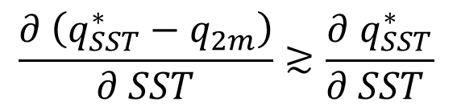
Conclusions
Lively thermo - / dynamics
at the mesoscale!
MABL’
MABL moisture set by
SURFACE EVAPORATION
ENTRAINED DOWNWELLING
Feedback on surface LHF
$$\frac{∂ \left(q_{SST}^{∗}−q_{2m}\right)}{∂ SST}≳\frac{∂{ q}_{SST}^{∗}}{∂ SST }$$
SST’ < 0
SST’ > 0

Slide 11
References
Acquistapace, C., Meroni, A. N., Labbri, G., Lange, D., Späth, F., Abbas, S., and Bellenger, H. (2022): Fast atmospheric response to a cold oceanic mesoscale patch in the north-western tropical Atlantic, Journal of Geophysical Research: Atmospheres, 127, e2022JD036 799, https://doi.org/10.1029/2022JD036799
Bony, S. and Dufresne, J.-L. (2005): Marine boundary layer clouds at the heart of tropical cloud feedback uncertainties in climate models, Geophysical Research Letters, 32, https://doi.org/10.1029/2005GL023851
Borgnino, M., Desbiolles, F, Meroni, A., and Pasquero, C. (2025) : Lower Tropospheric Response to Local Sea Surface Temperature Anomalies: A Numerical Study in the EUREC4A Region, Geophysical Research Letters, 52, e2024GL112 294 https://doi.org/10.1029/2024GL112294
Conejero, C., Renault, L., Desbiolles, F., McWilliams, J. C., and Giordani, H. (2024): Near-Surface Atmospheric Response to Meso- and Sub-mesoscale Current and Thermal Feedbacks, Journal of Physical Oceanography, 54, 823–848, https://doi.org/10.1175/2024.
Gentemann, C. L., Clayson, C. A., Brown, S., Lee, T., Parfitt, R., Farrar, J. T., Bourassa, M., Minnett, P. J., Seo, H., Gille, S. T. et al. (2020), Fluxsat: measuring the ocean–atmosphere turbulent exchange of heat and moisture from space, Remote Sensing 12(11), 1796, https://doi.org/10.3390/rs12111796
Naumann, A. K., Stevens, B. and Hohenegger, C. (2019), A moist conceptual model for the boundary layer structure
and radiatively driven shallow circulations in the trades , Journal of the Atmospheric Sciences 76(5), 1289–1306,
Seo, H., O’Neill, L. W., Bourassa, M. A., Czaja, A., Drushka, K., Edson, J. B., Fox-Kemper, B., Frenger, I., Gille, S. T., Kirtman, B. P.,
Minobe, S., Pendergrass, A. G., Renault, L., Roberts, M. J., Schneider, N., Small, R. J., Stoffelen, A., and Wang, Q. (2023): Ocean Mesoscale and Frontal-Scale Ocean-Atmosphere Interactions and Influence on Large-Scale Climate: A Review, Journal of Climate, 36, 1981–2013, https://doi.org/10.1175/JCLI-D-21-0982.1,

Slide 12
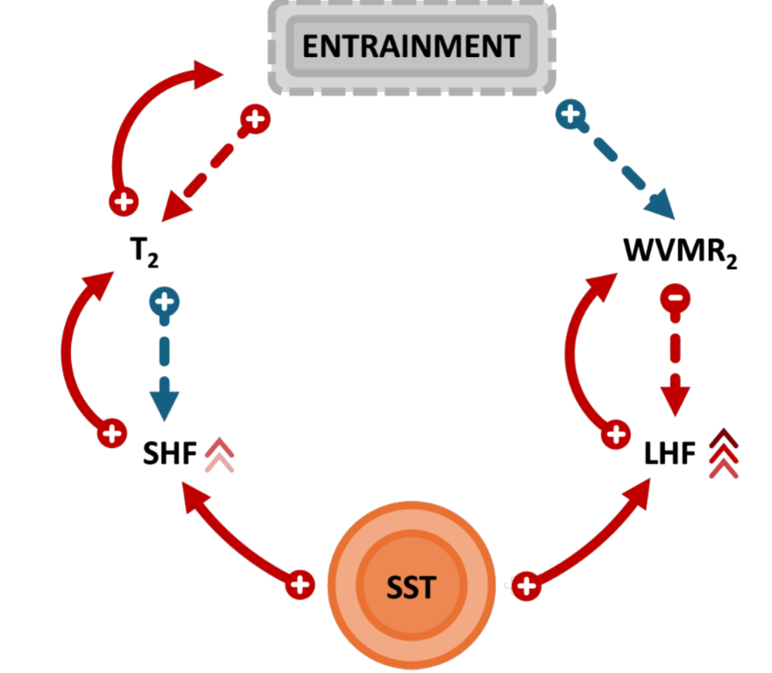
Enhanced entrainment WARMS and DRIES the MABL
Entrainment feedbacks
On surface fluxes
SST modifies fluxes
Borgnino et al. 2025

Slide 13

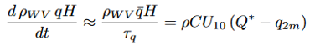
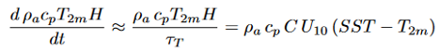
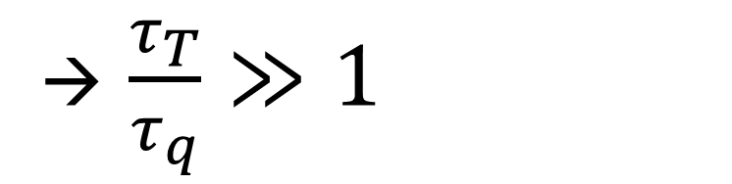
How to explain the different responses?
Different adjustment rates to surface fluxes?
→ $\frac{τ_{T}}{τ_{q}}≫1$
MABL’
SST’ < 0
SST’ > 0
Notes:
$q_{2m}$ IS SET BY BALANCE BETWEEN ENTRAINMENT AND SURFACE FLUXES

Slide 14
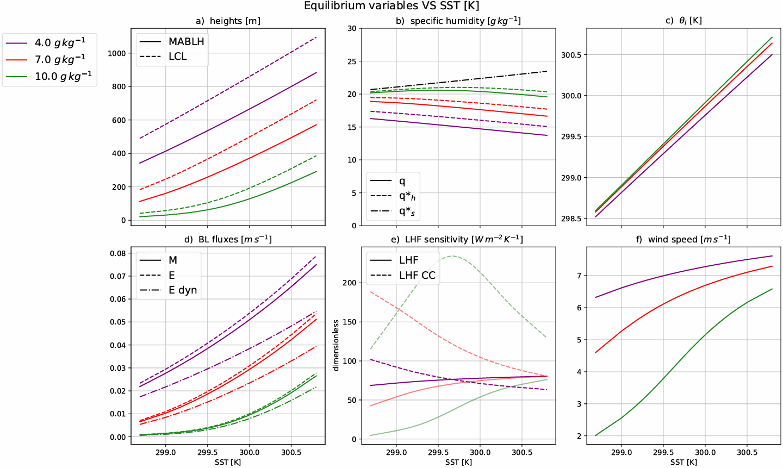
Full bulk model analysis
Equilibrium variables against SST

Slide 15
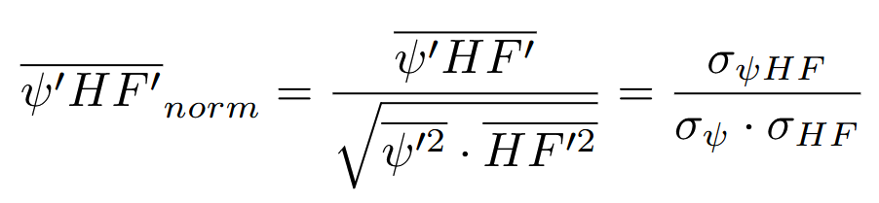
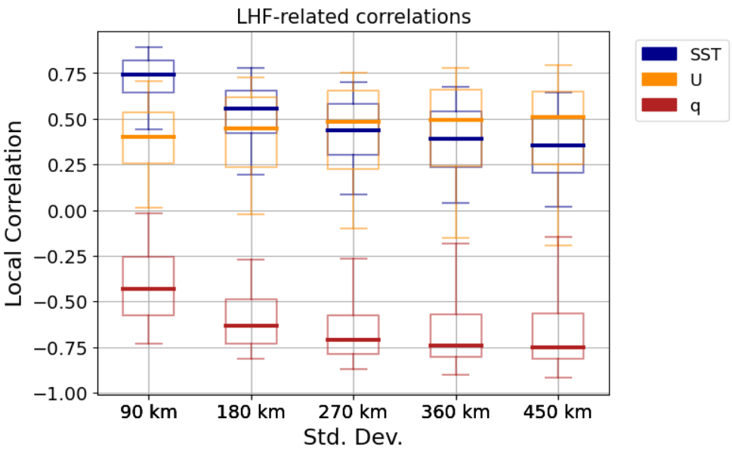
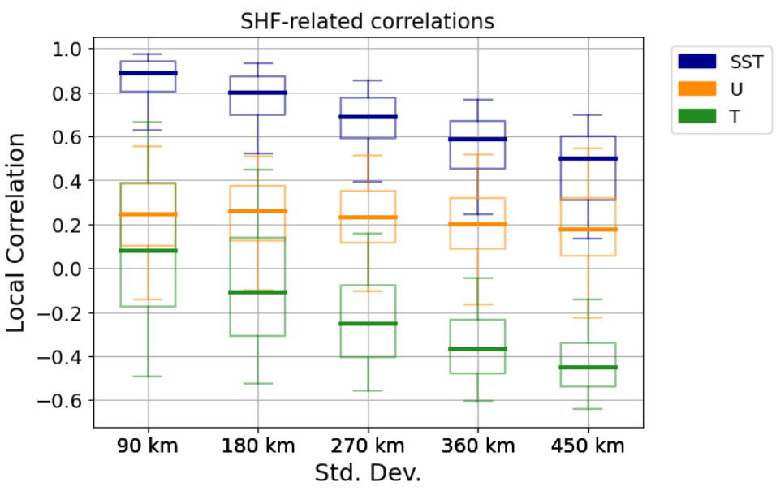
What’s driving heat fluxes?

Slide 16
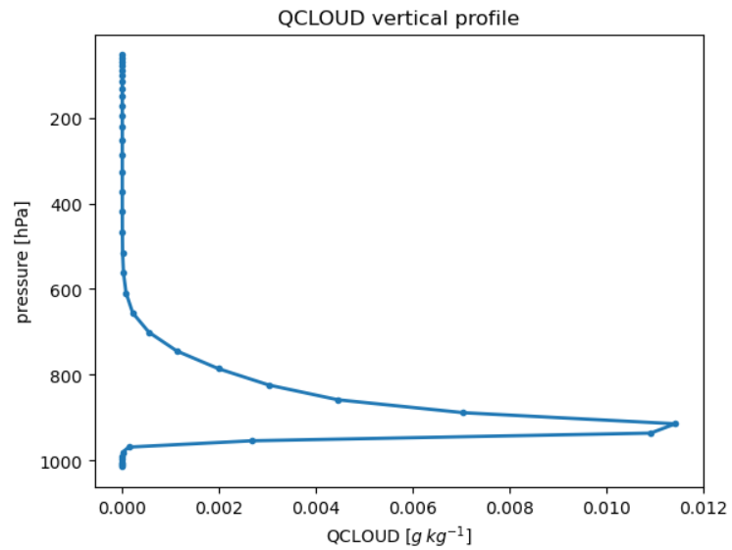
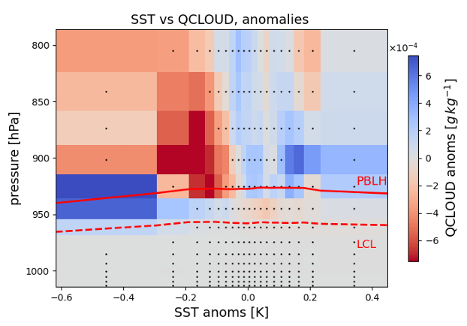
Cloud response – a first hint
QCLOUD anomalies
COLD anomalies: lower cloud base, closer to LCL
WARM anomalies: higher cloud base, more mixing between LCL and MABL top

Slide 17
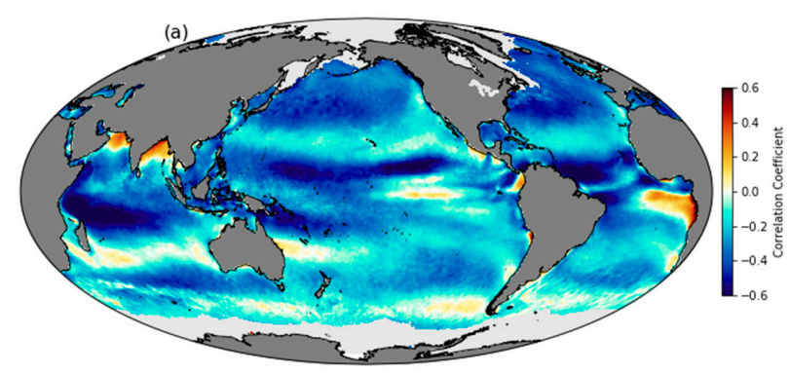
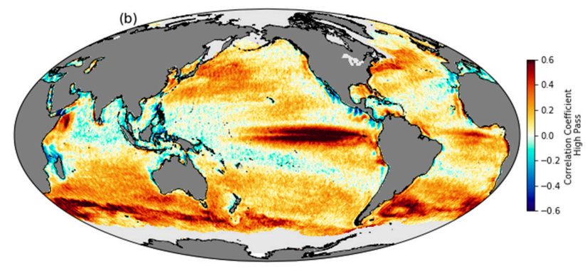
Introducing the local scale effects
Correlation between QuikScat wind speed and NOAA Optimum Interpolated SST using daily, 25-km-gridded data from 2000–2009.
Same, but for 1000km high-pass filtered data: notice the thorough change of correlation signs.
Gentemann et al. 2020

Slide 18
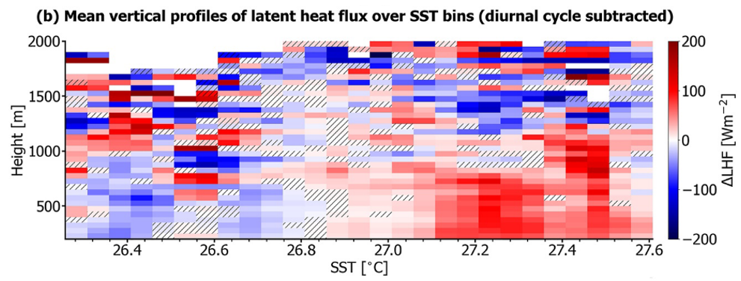
Observational evidences
Figure 8 from Acquistapace et al., 2022: Height-sea surface temperature (SST) section of the rain-free
diurnal anomalies of [...] (b) latent heat flux (LHF) estimated from Atmospheric Raman Temperature and Humidity. Sounder and Doppler lidars observations.
The measured MABL height settled at around 500m over colder SSTs and 750m over warmer ones

Slide 19
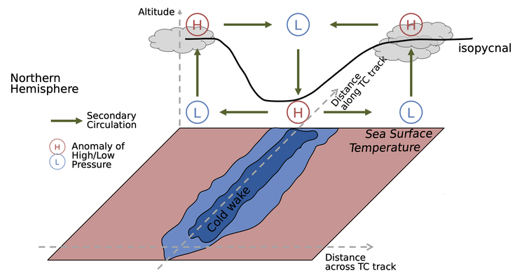
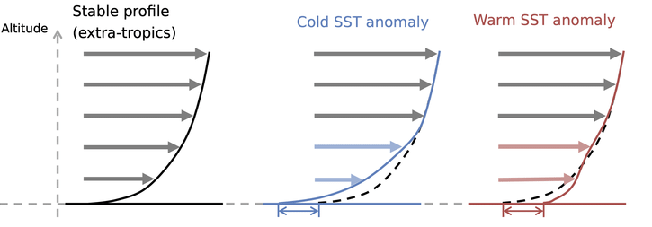
Introducing the local scale effects
Pressure Adjustment (PA)
Downward Momentum mixing (DMM)
$∇⋅\vec{u}=α_{PA}∇^{2}SST$
$∂_{r}u_{r}=α_{DM} ∂_{r}SST$
weak wind, neutral column
strong wind, unstable air
Secondary circulation
strong wind and
neutral stability conditions
THERMODYNAMIC FEEDBACKS
Altitude
Mean profile
Pasquero et al. 2021
Desbiolles et al. 2023
Wind speed
Notes:
conditions relative to SST structure scale

Slide 20
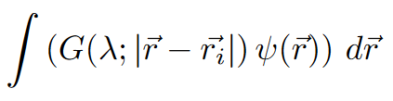
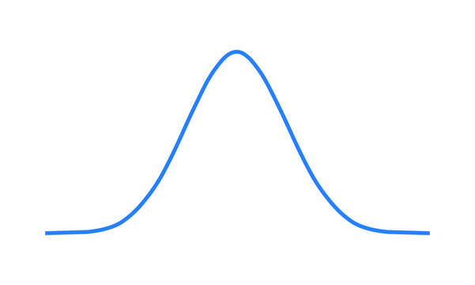
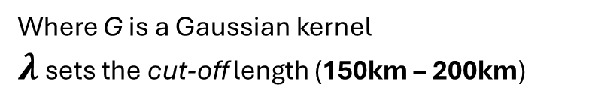
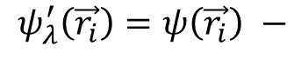
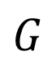
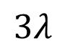
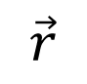
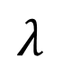
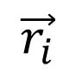
METHODS - a first glimpse
Anomalies == high-pass filtered data
$$ψ_{λ}^{′}\left(\vec{r_{i}}\right)=ψ\left(\vec{r_{i}}\right) −$$
Where G is a Gaussian kernel
$λ$ sets the cut-off length (150km – 200km)
$$G$$
$$λ$$
STATISTICAL SIGNIFICANCE: subsampling according to autorrelation lengthscales
$$\vec{r_{i}}$$
$$\vec{r}$$
$$3λ$$

Slide 21
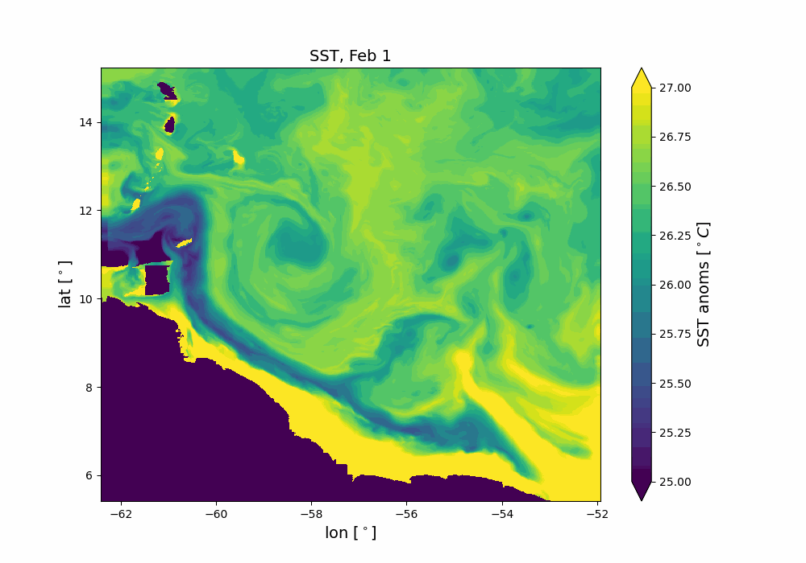
METHODS - a first glimpse
Anomalies == high-pass filtered data
$$ψ_{λ}^{′}\left(\vec{r_{i}}\right)=ψ\left(\vec{r_{i}}\right) −$$
Where G is a Gaussian kernel
$λ$ sets the cut-off length (150km – 200km)
$$G$$
$$λ$$
STATISTICAL SIGNIFICANCE: subsampling according to autorrelation lengthscales
$$\vec{r_{i}}$$
$$\vec{r}$$
$$3λ$$

